Slide 1
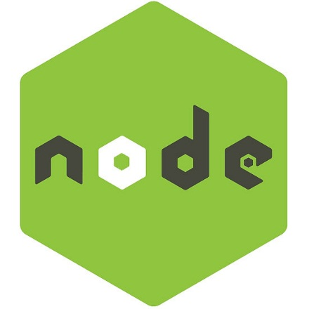
What is node.js?
Asynchronous i/o framework
Core in c++
Rest of it in javascript
Can handle thousands of Concurrent connections with Minimal overhead on a single process
It’s NOT a web framework, and it’s also NOT a language

Slide 2

node.js ?
- Its is a platform
- Execution of Java Script
- Outside the browser

Slide 3
Why node.js ?
● Non Blocking I/O
● Javascript Engine
● Single Thread with Event Loop
● 40,025 modules or more
● Windows, Linux, Mac
● 1 Language for Frontend and Backend

Slide 4

Why javascript ?!!!
Friendly callbacks
Ubiquitous
No I/o Primitives
One language to RULE them all
JavaScript is well known for client-side scripts running inside the browser
node.js is JavaScript running on the server-side
SSJS -> Server-Side JavaScript
  Use a language you know
  Use the same language for client side and server side

Slide 5
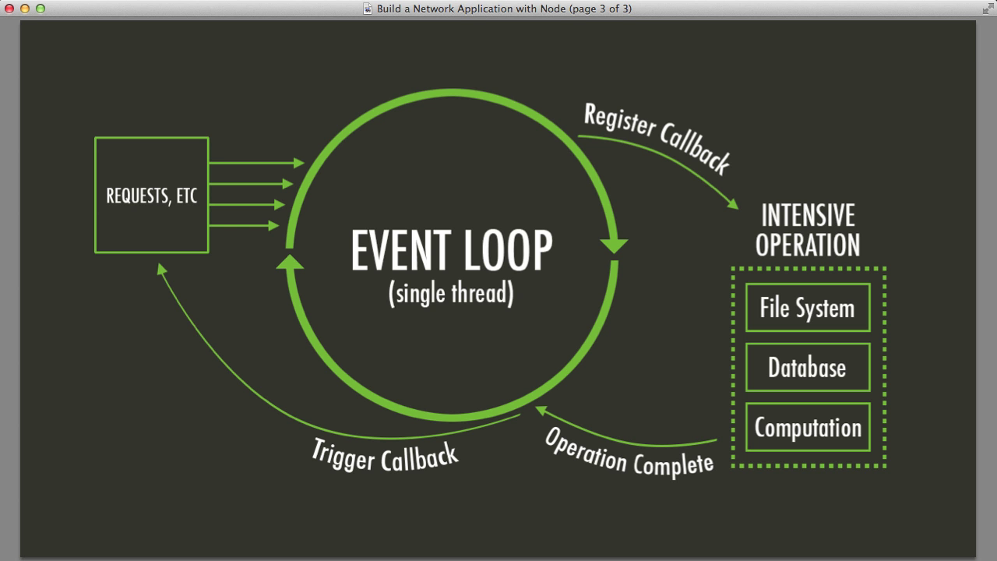
Node.js Event Loop
There are a couple of implications of this apparently very simple and basic model
  Avoid synchronous code at all costs because it blocks the event loop
  Which means: callbacks, callbacks, and more callbacks

Slide 6
Blocking…..
● Read data from file
● Show data
● Do other tasks
var data = fs.readFileSync( “test.txt” );
console.log( data );
console.log( “Do other tasks” );

Slide 7
Non-Blocking……
● Read data from file
● Do other tasks
fs.readFile( “test.txt”, function( err, data ) {
console.log(data);
});

Slide 8

Using module…..
var http = require(‘http’);
var fs = require(‘fs’);
var express = require(‘express’);

